Slide 1



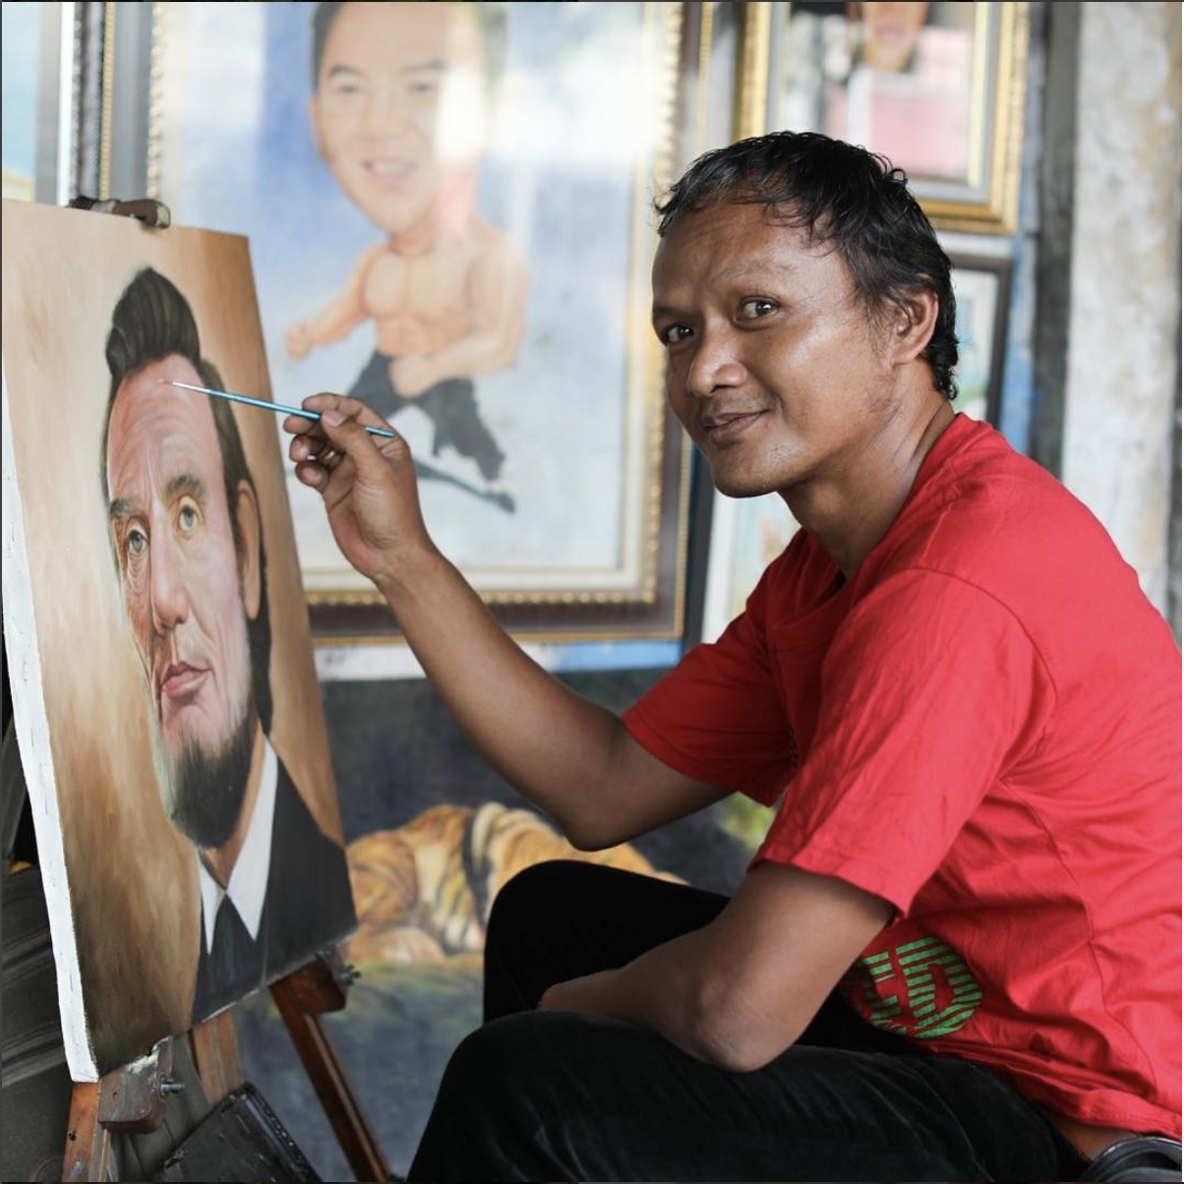

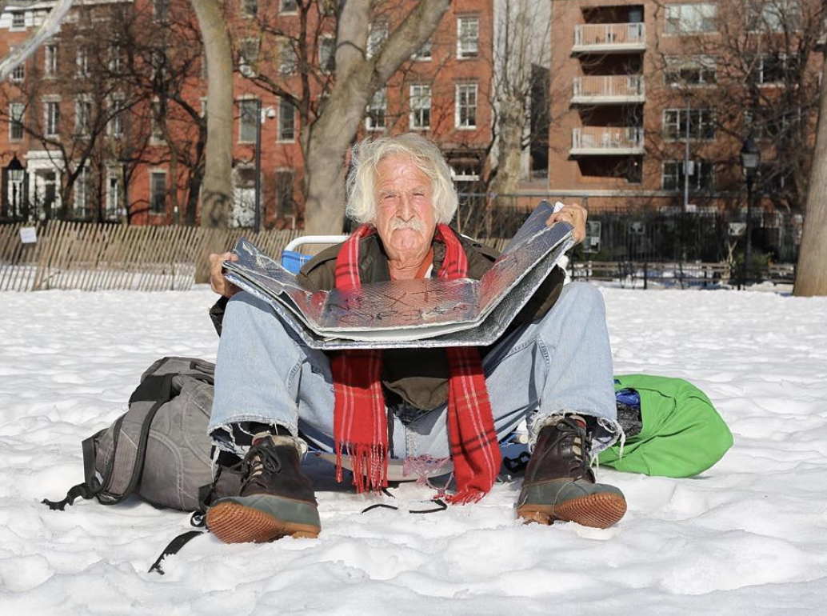
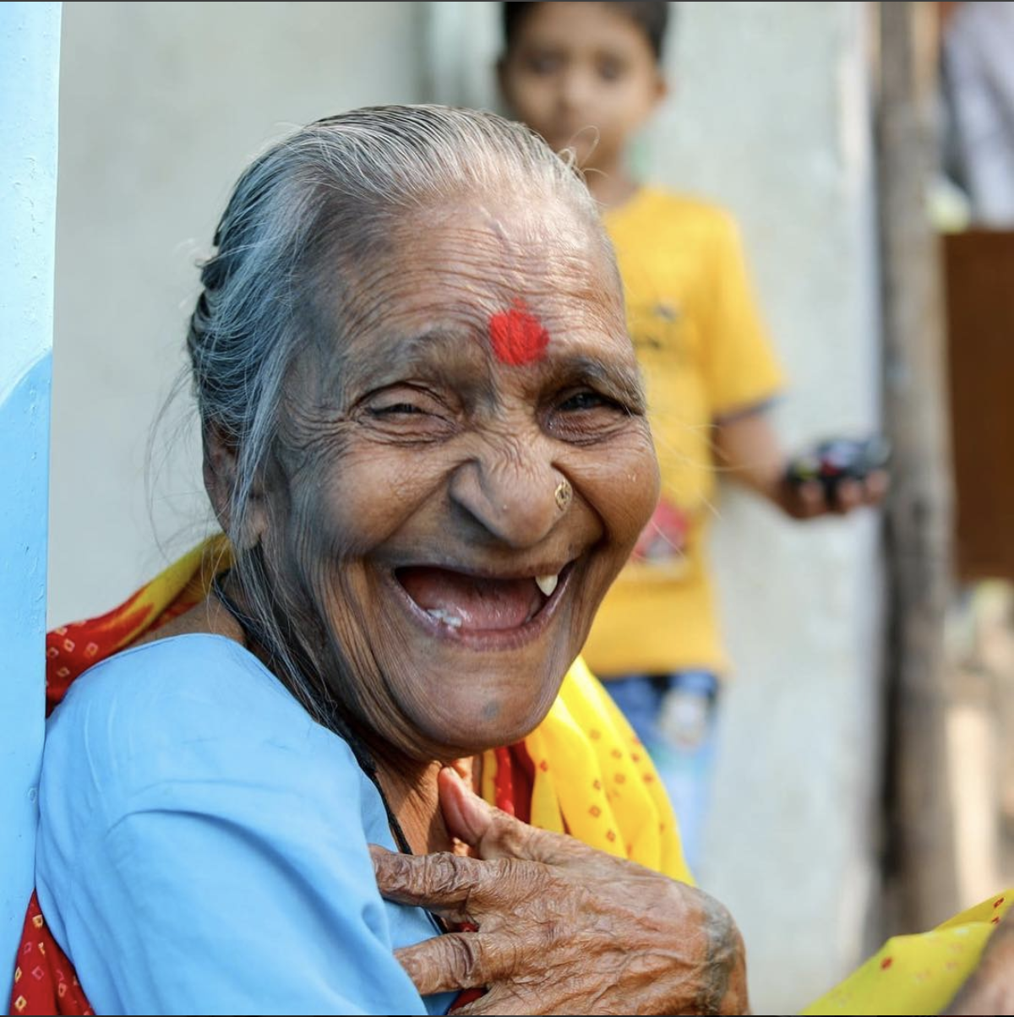

Humans of New York
Topic Modeling of Instagram Posts
Matt Barrett, Tim Lai, Christine Mulcahy, Elena Reynolds, and Brett Scroggins
Social Media Analytics
Spring 2018

Slide 2
Motivation
Our project explored the ‘Humans of New York’ Instagram account and its relationship between topics presented and interaction from fans.
Topic of Post
Number of Likes
Number of Comments
Notes:
From Wikipedia: Humans of New York (HONY) is a photoblog and book of street portraits and interviews collected on the streets of New York City.
HONY was started in November 2010 by photographer Brandon Stanton. It has developed a large following through social media. The blog had over 18 million followers on Facebook and around 7.5 million followers on Instagram by the end of last year. The official HONY Instagram account posts a variety of street portraits including the “story” told by the subject of the photo.
We will be using the information to demonstrate whether or not there is correlation between what topics may influence # of likes/# of comments, etc. This would be valuable for HONY if they were interested in showcasing different types of posts to garner even more social media attention.

Slide 3
Data Description
We used the Instagram_Vision.py to scrape 598 unique images posted by Humans of New York within the last two years.
From the output, we extracted:
Number of likes
Number of comments
Post location
“Story” words to use in topic modeling
Google image labels to use in topic modeling
Notes:
Data was retrieved using the Instavision.py script that was introduced in class. Our modifications involved setting the PAGE_URL to the HONY Instagram page and changing POST_LOADS sequentially until a sufficient number of posts were scraped. Because we could only scrape 40 posts at a time, we were not able to grab the entire collection of HONY stories in the time allotted for this project. Ultimately we were able to retrieve information for nearly 600 posts from the Humans of New York Instagram account. Information retrieved included # of likes, # of comments, post captions (the first comment is assumed to be the caption), post locations, and image labels.

Slide 4
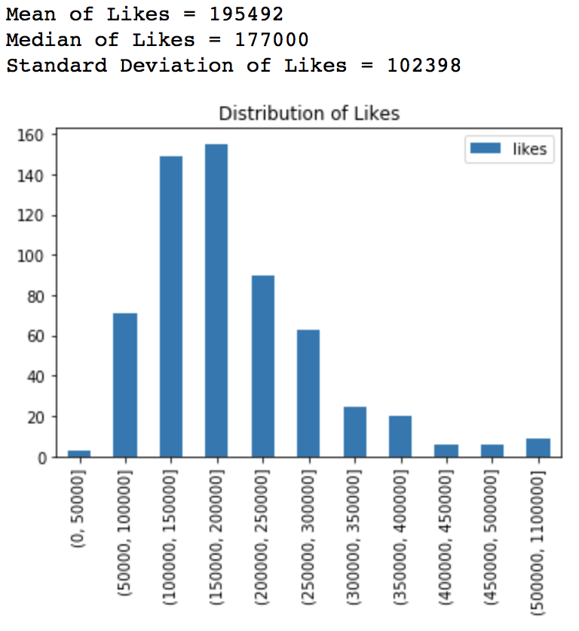
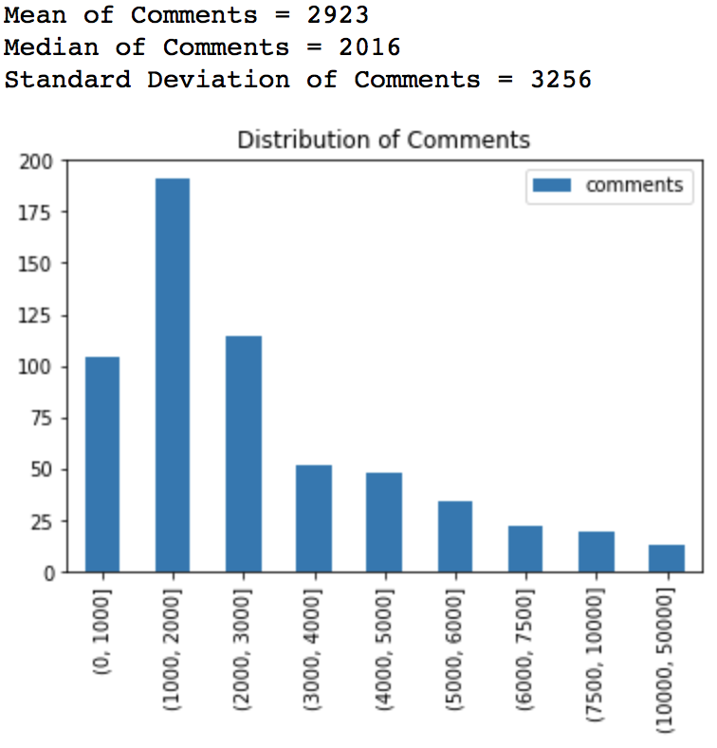
Variance of Likes and Comments
Notes:
When we explore the variance between our likes and comments distributions, we do see a varied distribution when binning the data; in other words, there is a variance in likes and comments that indicate that any correlations that we find will be meaningful from a statistical perspective. We did not want to see all posts have a high number of likes/comments or vice versa. With the variance shown, we feel more confident in inferring whether or not # of likes/comments are applicable to certain topics.
There are many similarities between the distribution of comments and likes across the Instagram postings on Humans of New York. The clearest to see is the similarity of skew in the distribution, with a long tail (tails truncated into large final bins). However, from analysis of the data the more interesting information was in the differences. Quite resoundingly the number of likes was not a strong indicator of number of comments, and vice versa. There appear to be different factors that resulted in high numbers of likes on some posts; and high number of comments on others.

Slide 5
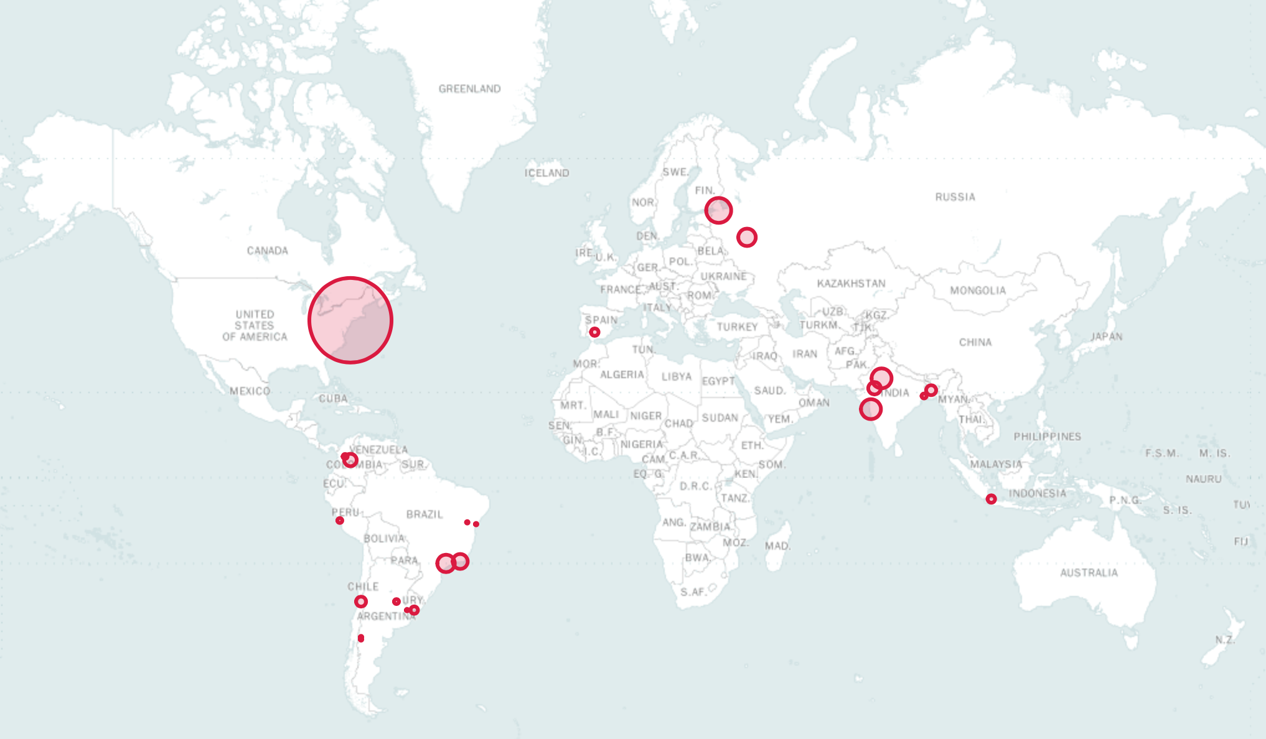
Geographic Locations
Top Locations:
NYC
Mumbai
Jaipur
São Paolo
Rio de Janeiro
Notes:
While HONY photographer Brandon Stanton primarily posts photos of civilians around NYC, he has also shared stories from trips outside of the US. At the end of each caption for photos not taken in NYC, Stanton consistently labels the location in parentheses. This fact allowed us to extract the location into a new column using regular expressions, assuming that whenever no match was found, the location was NYC.
This map shows the frequency of each location within our sample of 598 posts. We found New York City to be the location of 328 of these posts, with the remaining minority of the posts scattered across cities in India, Brazil, Russia, Colombia, Bangladesh, Argentina, and Indonesia.
Supplement: the map is actually interactive and has been submitted in the form of a HTML file in addition to this PowerPoint. In the interactive version, hovering over each circle actually displays the city’s name.

Slide 6
Topic Modeling from “Stories”
Topic 0: Pet care
Topic 1: Daily routine
Topic 2: Health
Topic 3: Separation anxiety
Topic 4: Business travel
Topic 5: Milestones
Topic 6: Mourning
Topic 7: Fathers/kids
Topic 8: Jobs
Topic 9: Mom/kids
Topic 10: Mothers/school
Topic 11: Struggle
Topic 12: Love/family/parents
Topic 13: Sons/bravery
Topic 14: Marriage
Notes:
We chose to model 15 topics because a variety of topics come across in HONY posts. Fewer topics contained too much overlap and more topics became unmanageable. We used GenSim’s LDAModel to select our topics. In the above slide, we labeled the 15 topics based on the model’s chosen words for each topic. These topics maintain the central theme of the HONY Instagram account’s mission: focusing on relationship and life challenges while describing different types of relational and life stories.
Some interesting trends that we identified were that parents were heavily featured in multiple topics. Also, topics about life challenges and struggling (as aforementioned). At this point, we were very curious to see if some topics which would be perceived as more sentimental would generate more social media attention.

Slide 7
Analysis of Topics from “Stories”
Likes Regression
Likes = 186408.8 + 5854.9*T0 + (-13525.9)*T1 + (-22933.6)*T2 + 11551.4*T3 + 11670.6*T4 + (-19903.5)*T5 + 7751.8*T6 + 12748.5*T7 + (-10224.8)*T8 + 26662.4*T9 + 32074.5*T10 + (-12265.3)*T11 + 27366.3*T12 + 2406.2*T13 + 10248.4*T14
RMSE = 99,353.4
Comments Regression
Comments = 3062.2 + 596.3 *T0 + (-1223.7)*T1 + ( -210.3)*T2 + 220.2*T3 + (-562.9)*T4 + (-756.6)*T5 + (-647.5)*T6 + 448.8*T7 + (-482.9)*T8 + 85.6*T9 + 201.6*T10 + (-469.7)*T11 + 150.6*T12 + 1650.5*T13 + 381.0*T14
RMSE = 3,186.2
Notes:
Reminder: topics from “stories” means we ran the LDAModel on the words in the post’s caption.
Grayed out topics were not statistically significant.
We hoped that these regression equations would allow us to see the value of each topic relative to its effect on number of likes and comments.However, many of the topics were found not to be statistically significant. For likes, “mothers/school” seems to have a positive impact on the number of likes. For comments, “sons/bravery” has a positive impact and “daily routine” has a negative impact on the number of comments.
The final aspect of these regressions to mention is the intercepts in the equations. These intercepts represent the base number of likes and comments that can be expected on a HONY Instagram post. This data point can provide HONY with an idea of what their Instagram brand is worth without support. From our calculations, these values are ~186,000 likes and ~3062 comments.

Slide 8
Topic Modeling from Google Cloud Vision Image Labels
Topic 0: Black Tie
Topic 1: Traffic
Topic 2: Food + Drink
Topic 3: Dogs
Topic 4: Eyewear
Topic 5: Outdoors
Topic 6: Beach
Topic 7: Transportation
Topic 8: Technology
Topic 9: Elderly
Topic 10: Marketplace
Topic 11: Fashion
Topic 12: Socializing
Topic 13: Business
Topic 14: Happiness
Notes:
Similar to the topics we modeled from “Stories”, we also chose to model 15 topics for image labels that we acquired from the HONY posts. 15 remained a good number for us to see a variety of topics in the posts.
In these topic modeling clusters, the topics described more of the different types of images that have been presented. There is high variation in the topics, with expected ones (i.e. dogs and fashion) vs. other topics (i.e. black tie, eyewear). Our intent was to have image labels provide a different approach to topic modeling. Are there certain features in photos that are consistently posted? What kinds of images garner the most likes and comments? Again, this is very similar to what we investigated from “Stories”, but this is just another approach in reviewing the post data.

Slide 9
Analysis of Topics from Google Cloud Vision image labels
Likes Regression
Likes = 206235.8 + 70010.4*T0 + (-10029.6) *T1 + 17458.9*T2 + 44863.7 *T3 + (-3534.6)*T4 + (-14569.9)*T5 + (-23271.3) *T6 + (-29999.1)*T7 + (-68204.5)*T8 + (-7530.9)*T9 + (-5435.6)*T10 + 14356.5*T11 + (-23949.6)*T12 + (-22760.4)*T13 + 30276.3*T14
RMSE = 97,787.0
Comments Regression
Comments = 3277.8 + (-284.5)*T0 + (-502.7)*T1 + ( -1044.1)*T2 + 1919.2*T3 + (-520.6)*T4 + ( -424.8)*T5 + 767.8*T6 + 181.9*T7 + (-1217.6)*T8 + (-54.1)*T9 + (-836.3)*T10 + 891.8*T11 + 579.0*T12 + ( -131.0)*T13 + (-99.9)*T14
RMSE = 3,186.7
Notes:
Greyed out topics are not statistically significant. Underlined topics changed signs from likes to comments regression.
Significant topics in likes: 0,3,7,8,12,14
Significant topics in comments: 3,8
As seen with these regression equations, we can see that there are an equal number of positive and negative coefficients for both the Likes and Comments regressions. The one statistically significant topic with a positive coefficient for both Likes and Comments was Topic 3 (Dogs) while the statistically significant topic with negative coefficients was Topic 8 (Technology). Because likes and comments can be attributed to human emotion, it makes sense that posts with animals (here more specifically dogs) would generate a more positive social sentiment. Conversely, if Google had identified the HONY post as including some sort of Technology, we would expect less likes and comments. It should be noted that the RMSE’s calculated for both regressions are somewhat accurate - the likes and comments can be predicted to an accuracy with a fair level of confidence.
As with the previous topic model, we were again interested in looking at the intercepts in the equations. These intercepts represent the base number of likes and comments that can be expected on a HONY Instagram post. This data point can provide HONY with an idea of what their Instagram brand is worth without support relative to image tags from Google. From our calculations, these values are ~206,000 likes and ~3300 comments. This is a result close to the default like and comments level that we saw from our previous topic modeling, but about 10% higher on both counts.

Slide 10
Next Steps
Scrape all remaining posts
Unexplored factors that might influence the model:
Change in followers over time
Day of week/time of day posted
Length of the caption
Location of post
Current events that influence the public’s emotional reaction
Possible changes to the target variable:
Regress on a combination of likes and comments together
Filter out meaningless comments (e.g. “@barua” - tagging a friend)
Notes:
We could expand on our model by investigating more factors that could influence the model in addition to the topics.
We can also consider changing our target variable to include/exclude likes, comments, or a subset of comments.

